Slide 1
Lecture 3
Assumptions and models in engineering
Units
Research basics

Slide 2
How to research
We spoke a lot about its importance last week
We did not a speak a lot about strategies to do it effectively
It is not a straight line path!
Everyone at university does it

Slide 3
Start with information
How does it work?
How have people solved the problem in the past?
What are the underlying principles?
What is the current “state of the art”
This is what most people think when you say the word research
Sitting in a library reading books
I would call it a “literature review”

Slide 4
Sources of information
Google it!
Wikipedia
Great place to start
I use it all the time
Don’t bet the house on it being perfect
User manuals
Tutorials
Online
Textbooks
Written for students
Generally the a great resource if you can get one
Papers
Written by/for experts in the field
Lots of assumed knowledge
Dense (hours to read a paper)
Ease of use
increases
Authority
increases

Slide 5
Example
https://en.wikipedia.org/wiki/Trebuchet Problem identification/scoping stage
http://www.real-world-physics-problems.com/trebuchet-physics.html
http://www.aemma.org/training/trebuchet/trebmath35.pdf
Detailed design stage

Slide 6
References
Useful in tracking where information came from
Often you are interested in a related topic to what you are reading about
Question anything without them
Anecdotal evidence needs to be carefully checked

Slide 7
How long does it take?
You in the order of 10-50 hours (labs may count)
Final year (honours) students in the order of 10-50 days
PhD in the order of 10-100 weeks
The better you understand a field the easier it will be to work in it

Slide 8
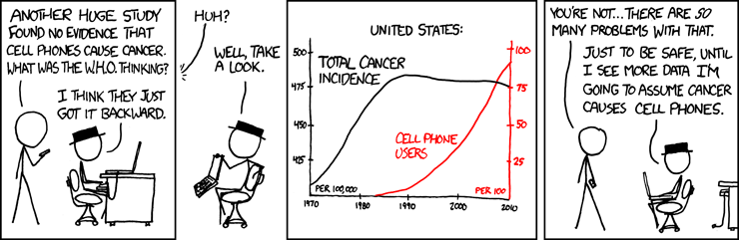
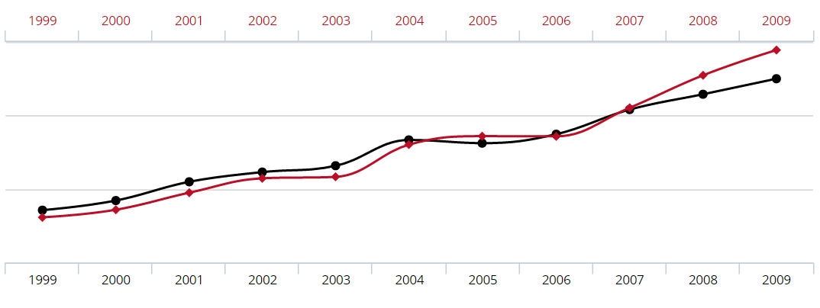
Correlation does not equal causation
For any two correlated events, A and B, the different possible relationships include:
A causes B (direct causation);
B causes A (reverse causation);
A and B are consequences of a common cause, but do not cause each other;
A causes B and B causes A (bidirectional or cyclic causation);
A causes C which causes B (indirect causation);
There is no connection between A and B; the correlation is a coincidence.
https://en.wikipedia.org/wiki/Correlation_does_not_imply_causation

Slide 9
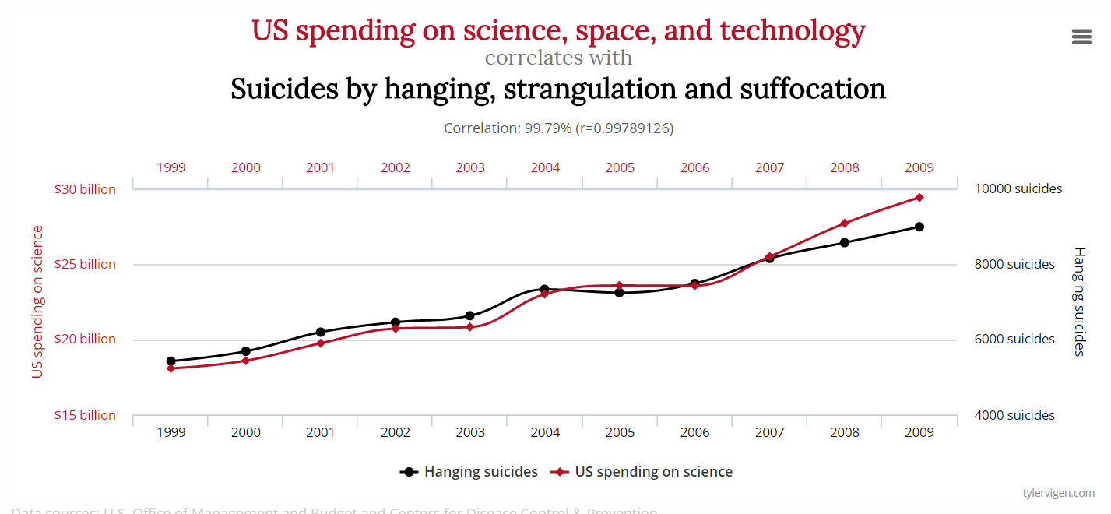
Thus there can be no conclusion made regarding the existence or the direction of a cause-and-effect relationship only from the fact that A and B are correlated. Determining whether there is an actual cause-and-effect relationship requires further investigation, even when the relationship between A and B is statistically significant, a large effect size is observed, or a large part of the variance is explained.
http://www.tylervigen.com/spurious-correlations

Slide 10
Measuring and interoperating data
Often done poorly
The better you understand the problem the easier it will be
It takes time
The most exciting phrase to hear in science, the one that heralds new discoveries, is not “Eureka!” (I found it!) but “That’s funny …” — Isaac Asimov

Slide 11
Prove it
Assume everyone thinks you are wrong
Play devils advocate within your team
Break your problem down into sections which can be independently tested
Calibration is incredibly important

Slide 12
Recap
Doing research is something you will become good at while at university
More diverse than you may have experienced so far
Understanding your topic is essential
Being critical is important
It takes time

Slide 13

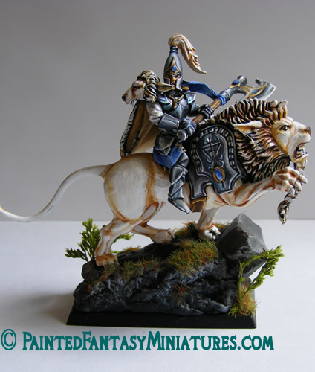
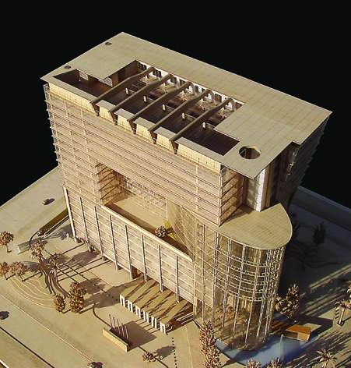

Making a model

Slide 15
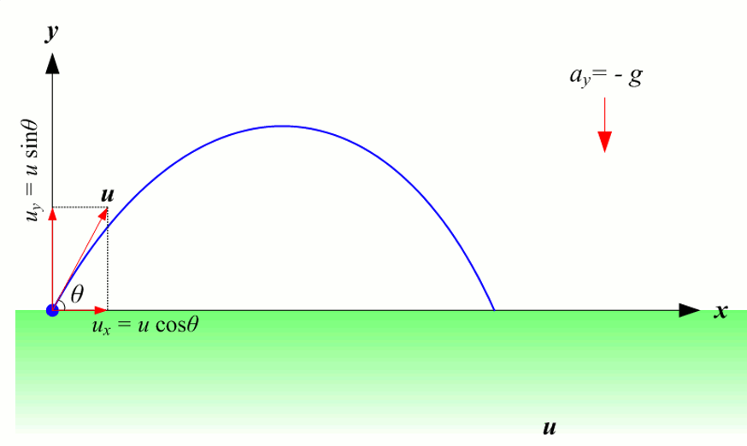
Projectile motion
Allows us to model the flight of an object
Incredibly useful tool in a great many fields
You will learn all about it in PHYS and MATH and MECH and transporting people via catapult…

Slide 16

$$a_{x}=0$$
$$v_{x}= \int{a_{x}}= u_{x}$$
$$s_{x}= \int{v_{x}}= \int{u_{x}}= u_{x}×t+ S_{ix}$$
$$a_{y}=−g$$
$$v_{y}= \int{a_{y}}= −g×t+ u_{y}$$
$$s_{y}= \int{v_{y}}= \int{−g×t+ u_{y}= −g×t^{2}}+ u_{y}×t+ S_{iy}$$

Slide 17
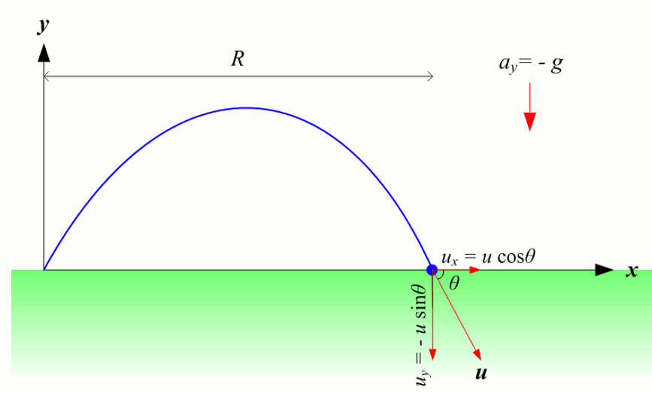
Using the model
Distance travelled: set s_{y} = 0, solve for t, substitute t into eqn. for s_{x} and solve
Maximum height: set v_{y} = 0, solve for t, substitute t into eqn. for s_{y} and solve

Slide 18
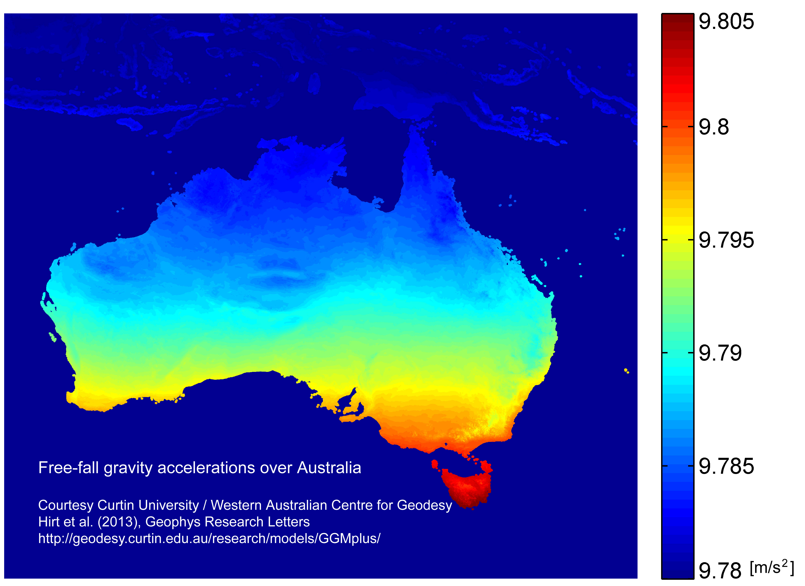
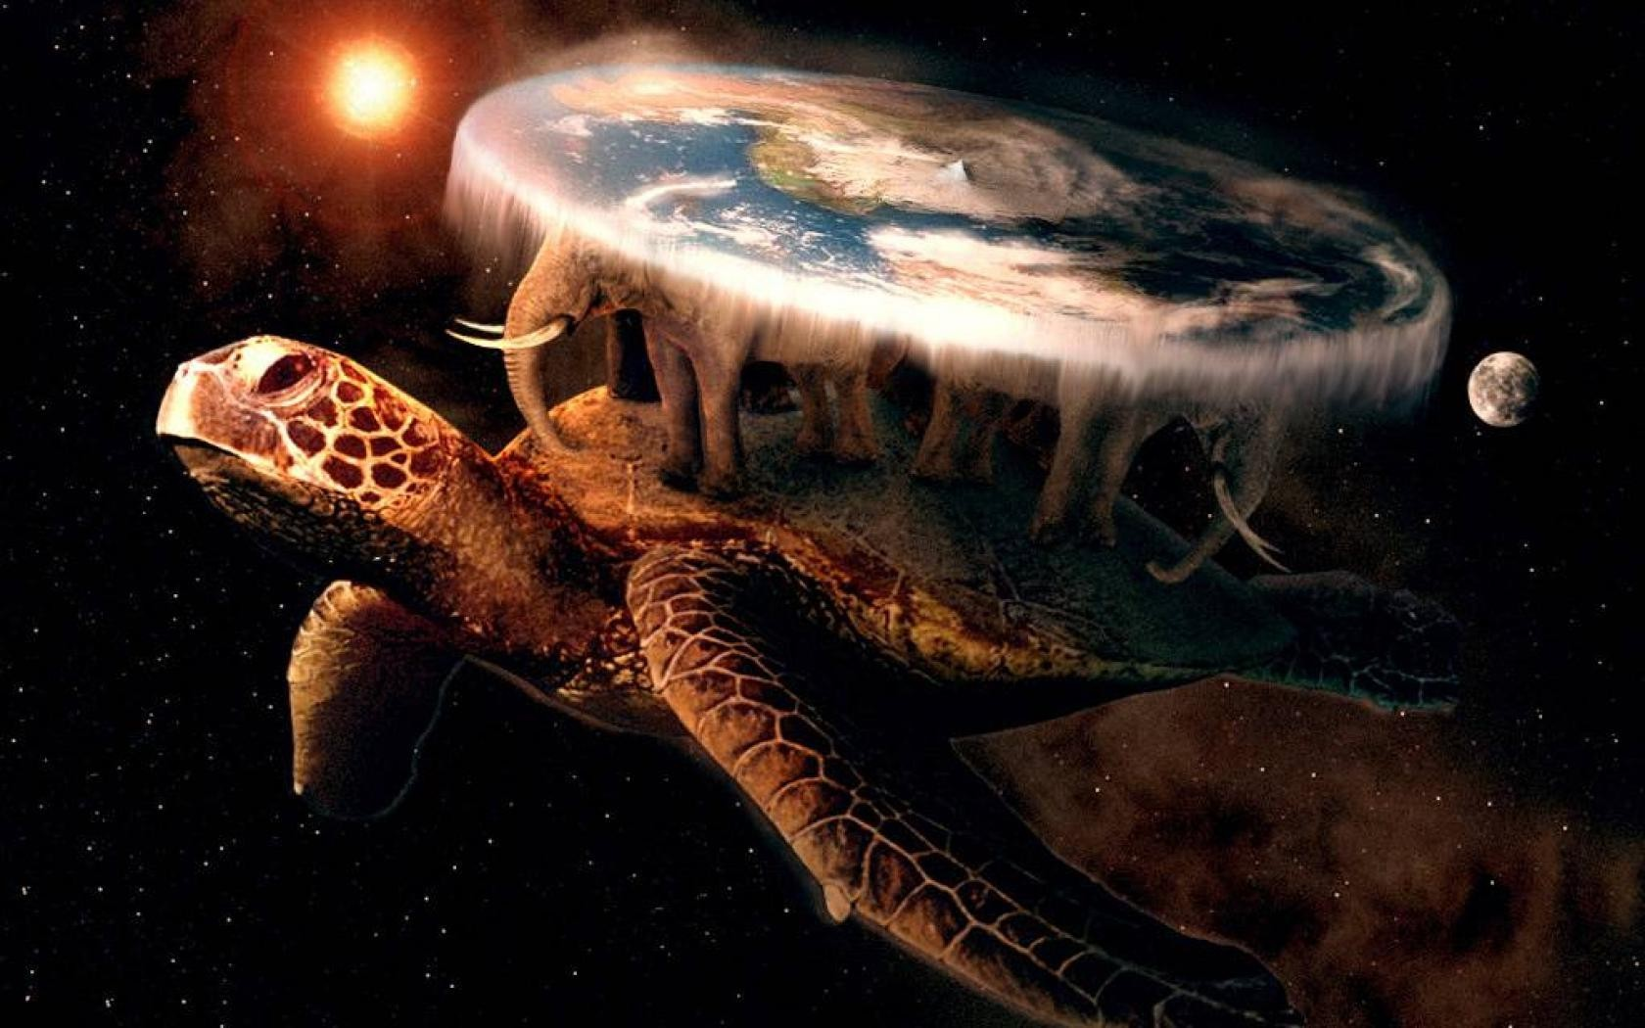
Assumptions made:
No drag!
Gravity is constant (and equal to…)
Earth is flat (and not spinning)
Projectile is symmetric
No velocity in or out of the page (2D)
Classical laws of physics (no relativity)

Slide 19
Basically everything you know is an assumption!
Cogito ergo sum René Descartes (I think therefore I am)
Less/better assumptions means more accurate
Better assumptions means more work
Diminishing returns
gravity = 10? 9.81? 9.795?
Your solution is only as good as your worst assumption!
You should only quote an answer as good as your worst assumption

Slide 20
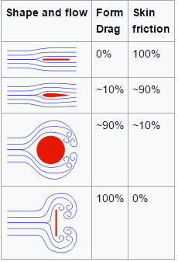
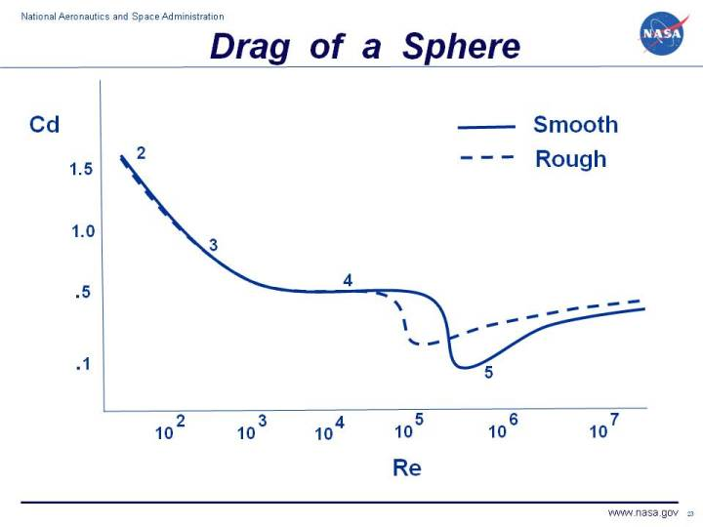

Drag assumption
$$F_{d}= \frac{1}{2} ρ v^{2}C_{d}A$$
$$Re=\frac{vD}{ν}$$

Slide 21
Example situations:
Our assumptions:
No drag!
Gravity is constant (and equal to…)
Earth is flat (and not spinning)
Projectile is symmetric
No velocity in or out of the page
Classical laws of physics (no relativity)
Throwing a ball
Probably pretty good for most cases
Swing bowling demonstrates non symmetric drag, sideways movement
Sydney to Malborne
Drag, gravity, Earth is flat…
Pioneer anomaly

Slide 22
Assumptions as an engineer
We make them all the time, we have to!
You need to understand them
Accuracy vs cost
They need to be stated clearly
Other people may use your work and make different assumptions, leading to failure

Slide 23
Assumptions in ENGG1500
Your projects will all require you to make large assumptions
Make sure they are well documented
Make sure your model is well explained

Slide 24
Units
Actually incredibly useful
Units of an equation always balance
This gives hints at the answer and allows you to check you are on the right track
Some units are made out of other units

Slide 25
SI units
Distance in Meters (m)
Mass in Kilograms (Kg)
Time in seconds (s)
Temperature in Kelvin (K)
Current in Amps (A)
Amount of a substance Mole (mol)
Luminous intensity Candela (Cd)

Slide 26
Deriving units
Force = Mass x Acceleration
N = Kg*m/s²
Force is Newtons (N) – Kg of force isn’t a thing!
Pressure = Force / Area
pa = Kg*m/s²/m²
https://en.wikipedia.org/wiki/International_System_of_Units#Base_units

Slide 27
Metric Units
1 Mm → 1 Km → 1 m → 1 mm → 1 µm
10⁶ → 10³ → 10⁰ → 10⁻³ → 10⁻⁶
The correct engineering unit is mm or m
(cm are dressmakers units ☺ )
Pressure is Pascals (Pa) but normally MPa
One Pa is 1 N per square Meter
One Mpa is 1 N per square mm

Slide 28
Imperial Units – Units that Mum’n’Dad (G’ma, G’dad) used
The United States still works in imperial units. This forces engineers in metric countries to encounter imperial units. A little knowledge goes a long way.
Length 1 Inch = 25.4 mm
(1/2” = 12.7 mm, ¼” = 6.35 mm, ¾” = 19.05 mm)
1 foot = 304.8 mm
Moral: if you see a ‘funny’ metric dimension convert it to imperial as see if it makes more sense.

Slide 29
An acre was defined in the Middle Ages, being the amount of land that could be ploughed in one day with a yoke of oxen.
The acre is a unit of land area used in the imperial and US customary systems. It is defined as the area of 1 chain (66 feet) by 1 furlong (660 feet), which is exactly equal to 1⁄640 of a square mile, 43,560 square feet, approximately 4,047 m², or about 40% of a hectare.
https://www.youtube.com/watch?v=Q8qQolqkTU0 –Watch for fun

Slide 30
The meter
The metre was originally defined in 1793 as one ten-millionth of the distance from the equator to the North Pole. In 1889, it was redefined in terms of a prototype metre bar (the actual bar used was subsequently changed twice). In 1960, the metre was redefined in terms of a certain number of wavelengths of a certain emission line of krypton-86. In 1983, the current definition was adopted.

Slide 31
Formatting
Capitalize units named after people, don’t capitalise other units
Capitalize prefixes that mean bigger, lower case for prefixes that mean smaller
MN (mega-Newton 10⁶ N) vs mN (milli-Newton 10⁻³ N)
Use a space between numbers and units
The abbreviation is a replacement for the word
Its not 1meter so its not 1m

Slide 32
Units Recap
Actually incredibly useful
Units of an equation always balance
This gives hints at the answer and allows you to check you are on the right track
Some units are made out of other units

